Slide 1
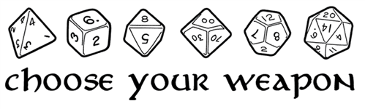
Internet Connected Dice
An Internet of things Proof of concept

Slide 2
Project Overview
How its done?
RGB sensor and colored dice
Photon & TCS230/TCS3200
How would it be sold?
Integrate with online tabletop RPG (Roll20)
Integrate with dice towers
How to Improve?
IR/UV visual sensor instead
Short range RFID instead

Slide 3
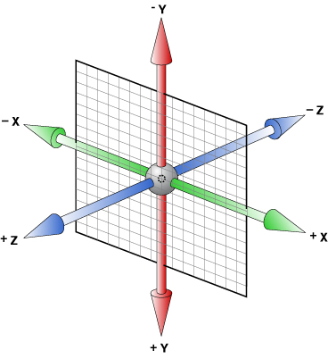
The Obvious & Bad Solution
Three Axis Accelerometer
Needs to be inside dice
Require power and battery
Requires transmission to base
Will likely effect balance
Passive Solution Needed

Slide 4
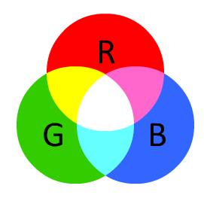
RGB Optical Detection
How it work:
Each side of dice has different color
These will be translated by RGB sensor to counts
These counts will be converted to color & number
Transmitted by photon to web
Problems
Visual interference from lights
Different values depending on light source
More accurate sensor needed
Highly variable background and color readings

Slide 5
Integrate with Online RPG
Tabletop RPG gaming is increasing in popularity
5.5 million people in the US in 2000 play RPG regularly
Increased visibility and popularity with podcasts and streams
Critical Roll Episode 1 has 185,000 views on YouTube
Online visibility and resources available
Online forums to discuss rules and strategy
Purchase user generated material
DM materials to run games better (Maps, Trackers, etc)
Online gaming material (Roll20.net)
Most online resources are to help or simulate an off-line experience
Roll20 , Skype and other tools simulate being there in person
Next step is rolling dice
1. According to Wizard of Coast 2000 survey

Slide 6
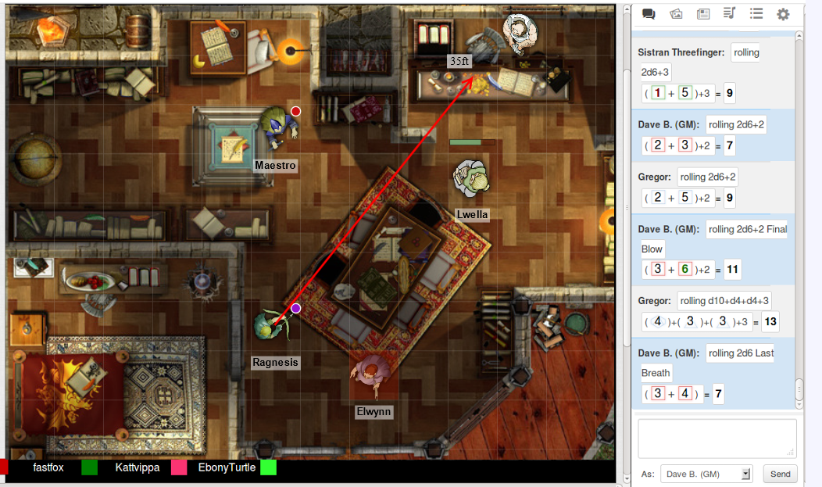
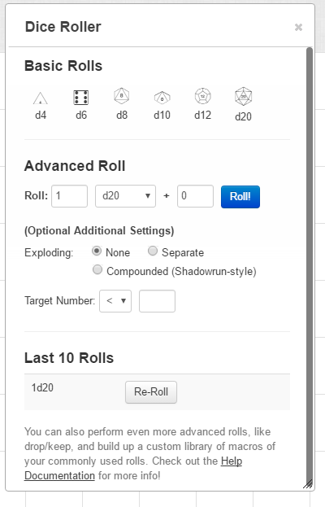
Online Simulates Offline Experience

Slide 7
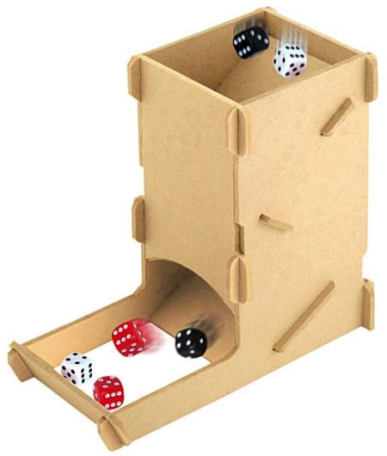
Integrate With Dice Tower
Existing market for dice towers
Currently used to randomize dice rolls and capture dice
Would sell as complete dice tower or add-on to existing
Install Detecting Technology

Slide 8
Next Steps:
Switch Optical Sensors
UV/ IR sensor screening
Determine interference in UV/IR Range
Determine UV/IR paints needed
More robust and capable of image analysis
More advanced image analysis
Detection and evaluation of multiple dice
Grid based analysis instead of counts
Test Feasibility of Short Range RFID
Decrease range of >20 cm to 1 cm
Need to ensure no interference from other sides
Determine RFID integration in dice
Determine feasibility of integrating RFID on each side
Determine how this effect balance
Determine how to manufacture at large scale

